Slide 1
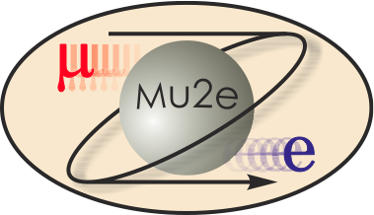
Mu2e CD-2 Review Template
Eric Prebys
Extinction
October 21-24, 2014

Slide 2
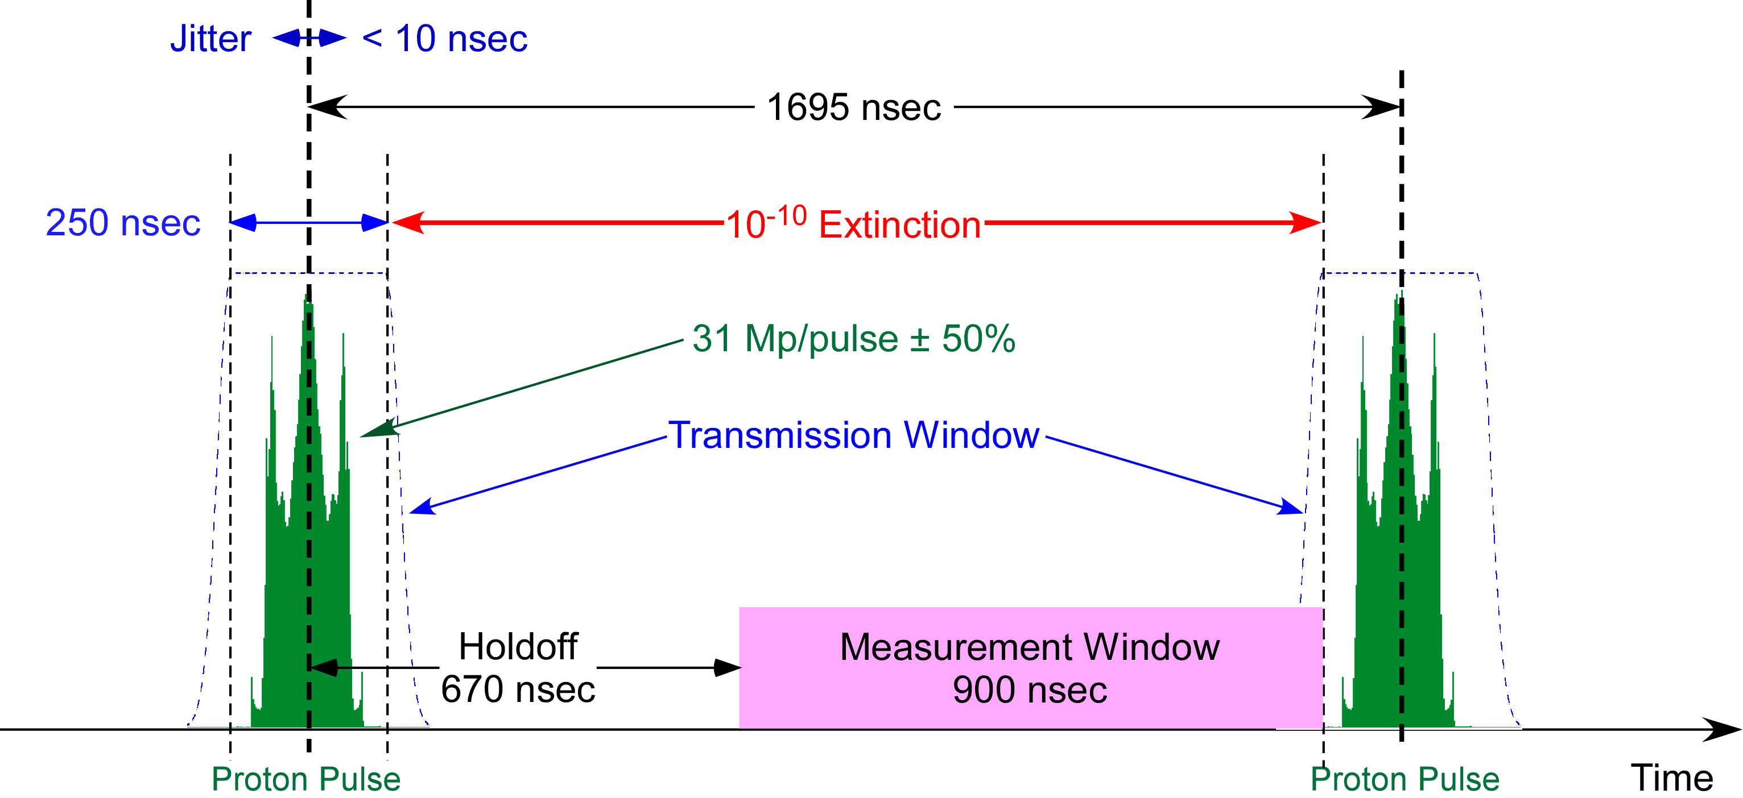
WBS 475.02.08 Extinction
The Mu2e experiment has very stringent limits on the amount of beam that appears between pulses
The extinction task is comprised of
Providing this level of extinction.
Monitoring to verify that we have achieved it.
We will address “Extinction” and “Extinction Monitoring” in separate talks

Slide 3
Organizational Breakdown
WBS 2.08
Extinction
E. Prebys Deputy: TJ Gardner
WBS 2.08.02
External Extinction
E. Prebys
WBS 2.08.03
Extinction Monitoring
P. Kasper
WBS 2.08.01
Conceptual
E. Prebys
WBS 2.08.04
Technical Documentation
E. Prebys

Slide 4
Organization of Talks
My talk:
Extinction System:
Requirements
Technical design
Projected performance
Value engineering, risks, etc…
Cost and schedule for both Extinction and Extinction Monitoring
P. Kasper’s talk:
Extinction Monitor
Requirements
Technical design
Projected performance
Value engineering, risks, etc

Slide 5
Extinction Requirements*
The total extinction requirement is
This is primarily driven by the need to eliminate radiative pion capture, as described in detail in Mu2e-DOC-1175
Extinction will be achieved in two steps
Our beam delivery technique will “naturally” provide an extinction of ~10⁻⁵ or better.
The “Internal Extinction Collimation” discussed at CD-1 will not be needed (see discussion under “value engineering”)
An “External Extinction System” will consist of a set of resonant dipoles and collimation system, such that only in time beam will be transmitted to the production target
Aiming for additional 10⁻⁷ extinction.
< 1 every ~300 bunches
*extinction monitor requirements will be discussed shortly

Slide 6
Principle of Operation of AC Dipole System
An angular deflection at the AC dipole cause a position displacement 90° later in phase advance
Define normalized deflection angle
In terms of this angle
Admittance of collimator (set to 40 π-mm-mr
β at AC dipole (=250 m)

Slide 7
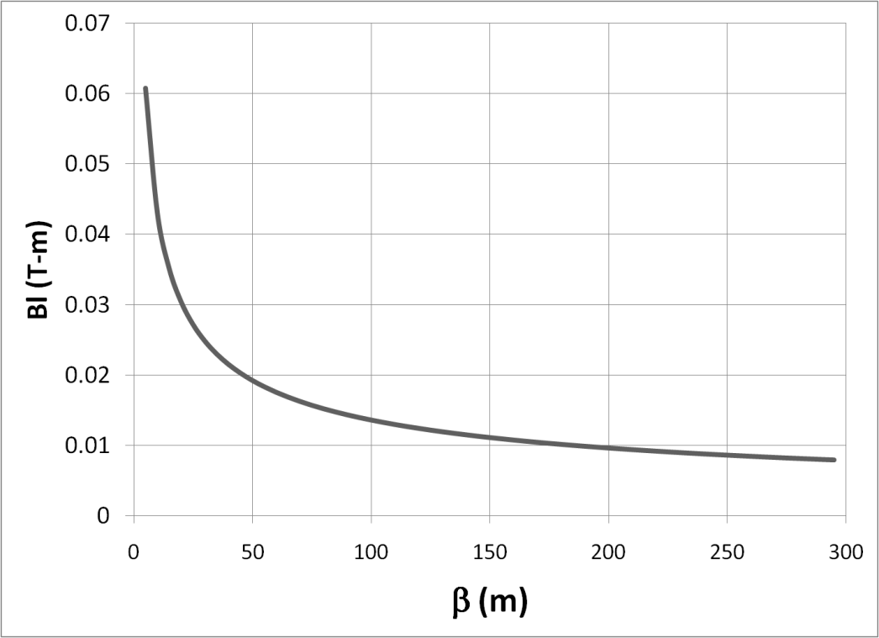
Design Considerations
Bend strength to extinguish:
Stored Energy:
➔Large β_{x}, long weak magnets
- Assume β_{x}=250m, L=6m
- Factor of 4 better than “typical” values of β_{x}=50m, L=2m
Driving consideration in beam line design!

Slide 8

Two Separate Collimation Issues
Phase space distribution at location of AC dipole
Beam core: out of time beam will be steered into the collimator or collimators downstream of the AC dipole
AC dipole shifts distribution along x’ axis in phase space
Admittance of downstream collimation system
High amplitude beam tails will be steered into the collimation channel, so they must be cleaned up upstream of the AC dipole

Slide 9
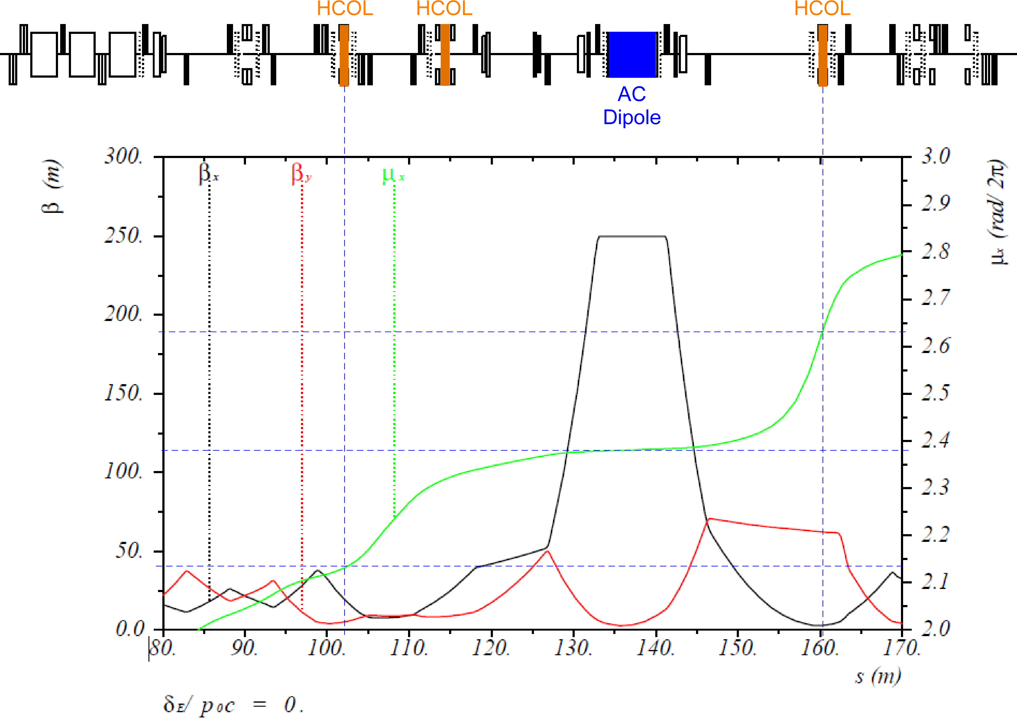
Extinction Optics*
Halo collimation
Extinction collimation
*E. Gianfelice

Slide 10
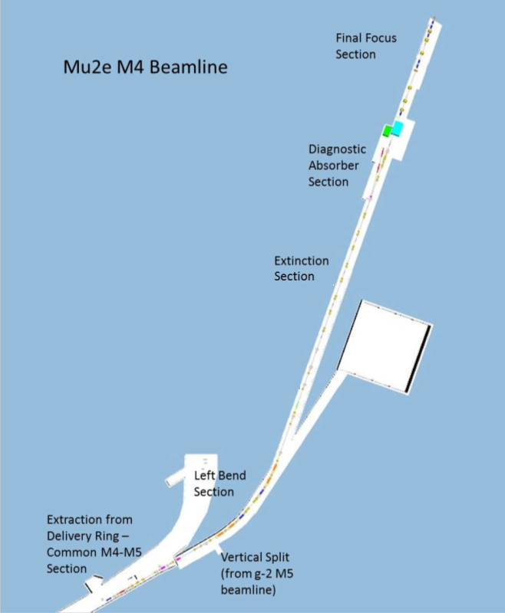
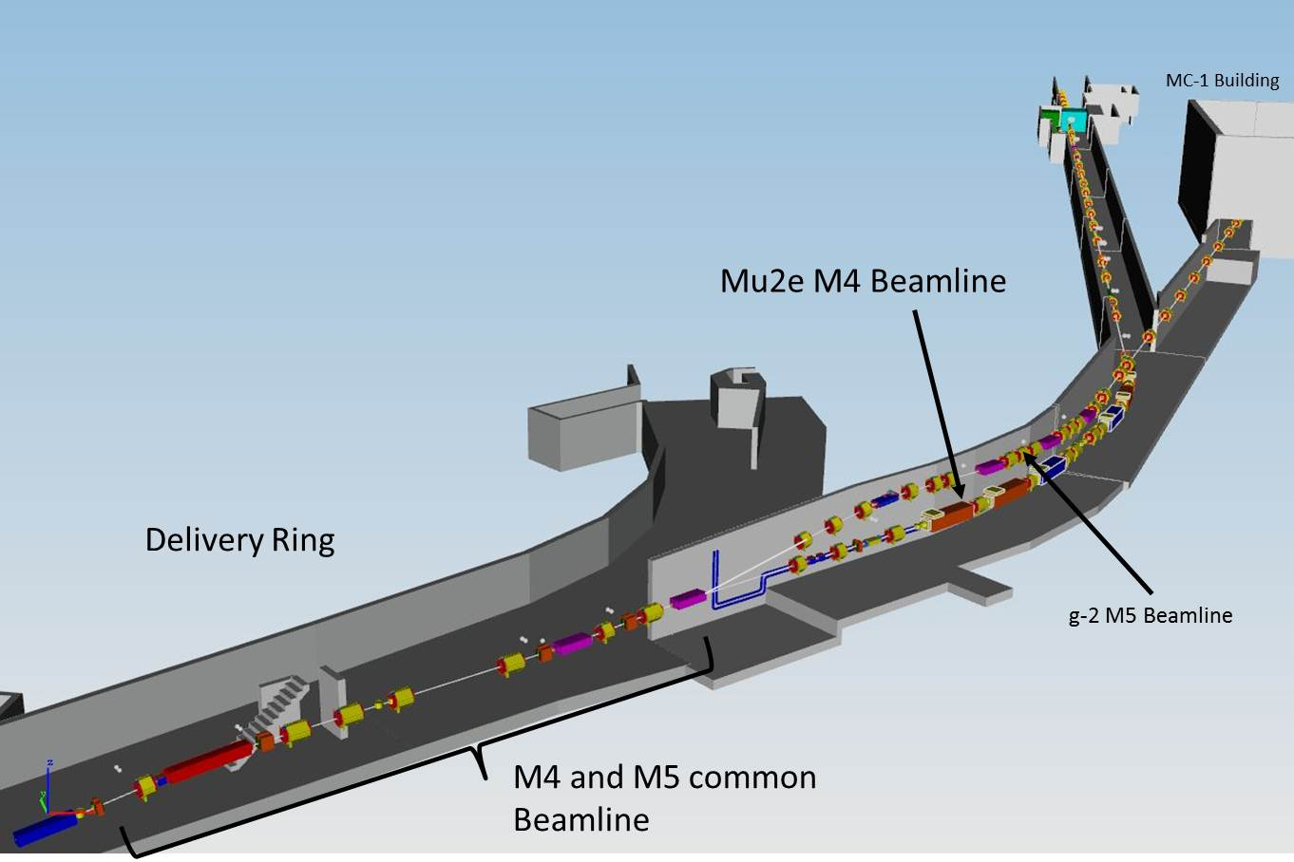
Mu2e Beam Line

Slide 11
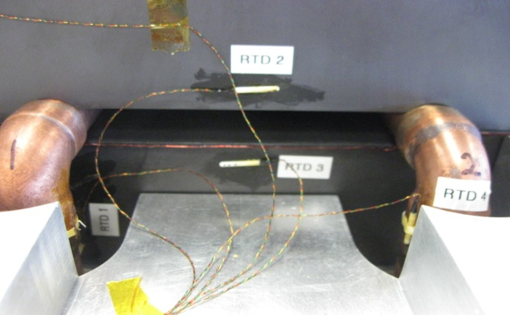
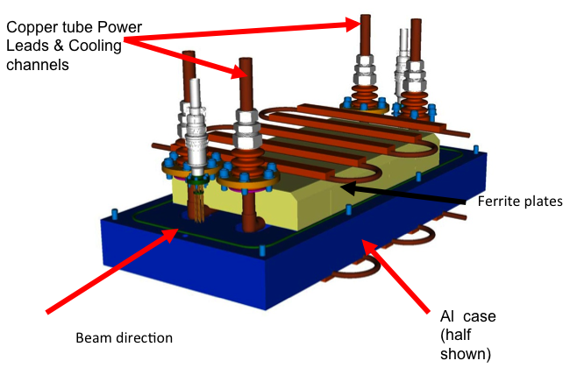
AC Dipole Design and Prototype
AC dipole system consists of 6 identical one meter elements, arranged in two 3-meter vacuum vessels.
Extensive tests done with half-meter prototype
meets all specificiations
Elements individually powered

Slide 12
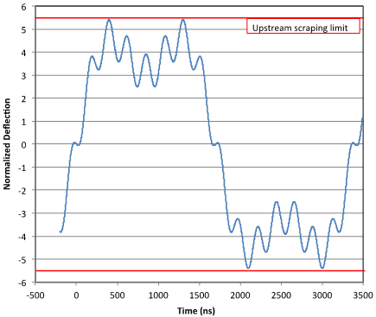
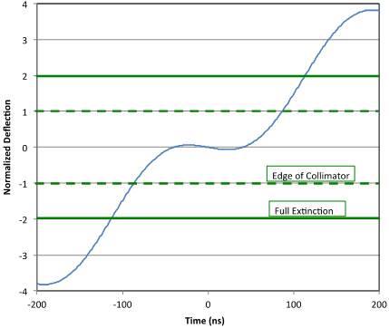
AC Dipole Harmonics
The AC dipole elements will be driven by 3 harmonics
2 elements @ 300 kHz (half bunch frequency), such that beam is transmitted at the nodes.
3 elements @ 4.5 MHz to reduce slewing during transmission
Optimized to maximize transmission of in-time beam.
1 elements @ 900 kHz, to reduce amplitude and prevent beam pipe scraping upstream of the collimator.

Slide 13
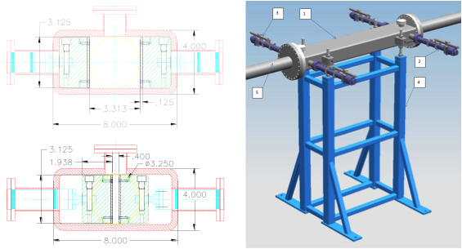
Collimator Design
Collimator based on designs previously used in Main Injector and Tevatron
Separate motion controllers/LVDTs at each end so position and angle can be precisely controlled
Collimator and stand:
Control and position measurement

Slide 14
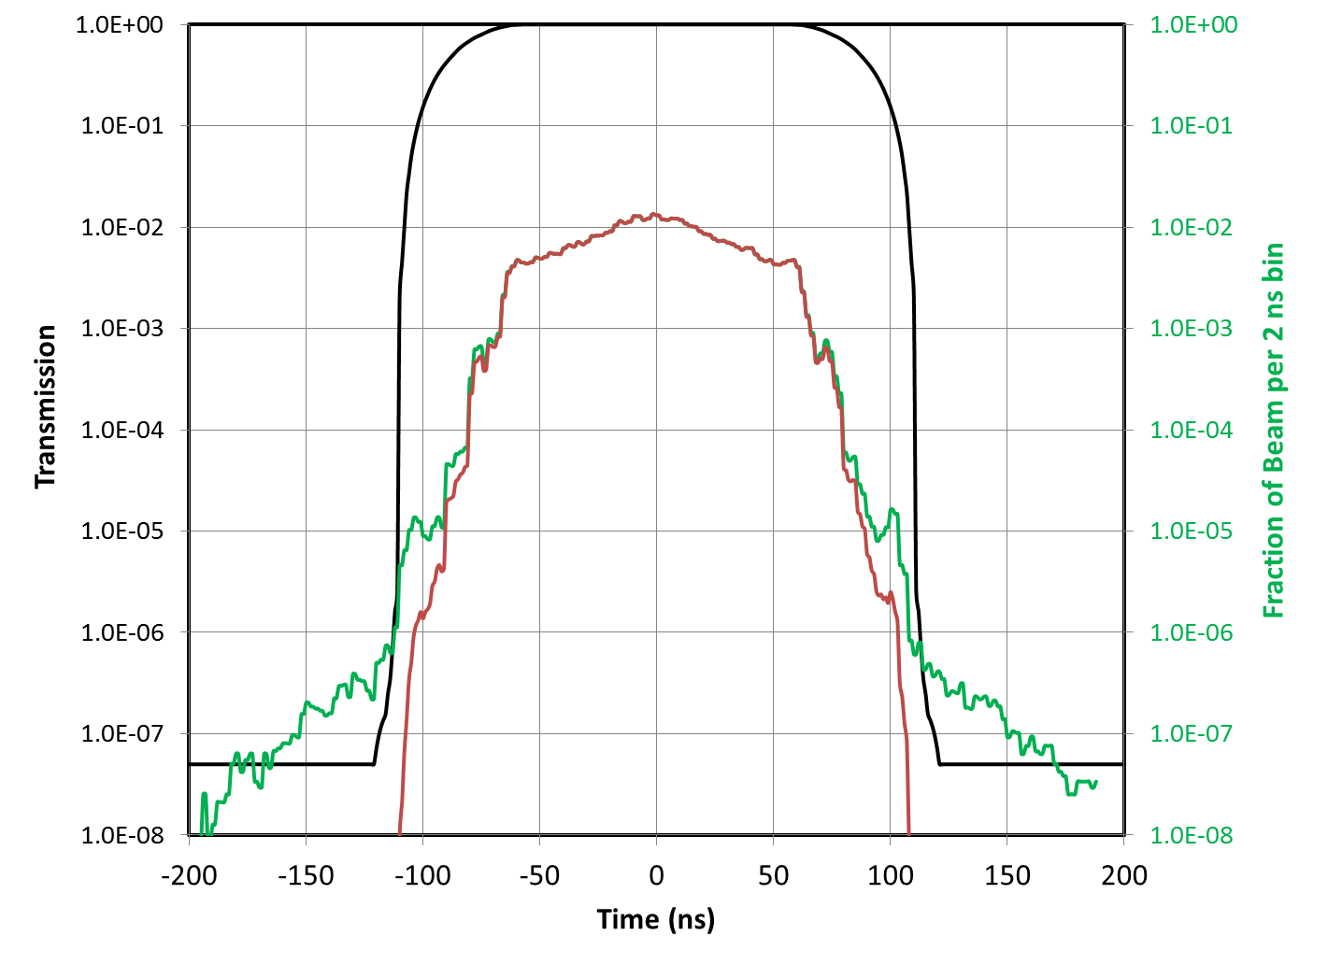
Extinction Performance
Two Models:
Beam distribution from ESME longitudinal tracking model in the Delivery Ring.
G4Beamline tracking model of extinction section of the M4 beamline. (Mu2e-DOC-5054)
Results:
Upstream extinction: 1.6×10⁻⁵
In-time beam transmission: 99.7%
Downstream extinction: 8×10^{-13†}
† This number assumes that there is no contribution from long transverse tails.
Extinction Transmission
Average Delivery Ring Distribution
Average Distribution on Target

Slide 15
Changes since CD-1
At CD-1, we were still considering the possibility that we might need collimation inside the Delivery Ring to reduce out of time beam.
Simulations showed this will not be necessary, so it was de-scoped.
CD-1 design had 5 collimators downstream of the AC dipole. New design has 2 upstream and 1 downstream.
The third harmonic has been added to the AC dipole system to prevent particles from scraping upstream of the collimator.

Slide 16
Value Engineering since CD-1
Elimination of internal extinction collimation (see previous slide).
Reduction in number of external extinction collimators from 5 to 3 (see previous slide).
Low frequency (300 kHz) power supply based on existing standard Fermilab (Krafczyk) design.

Slide 17
Remaining work before CD-3
The following designs are very mature
AC Dipole and power supply
Collimators
Upstream and downstream extinction monitors
These require only finalized designs and more accurate cost estimates
The only significant work before CD-3 is the finalization of the collimation upstream of the AC dipole to eliminate the large amplitude tails.
Working on this design in conjunction with the beam line design.

Slide 18
Quality Assurance
AC Dipole magnets and Power supplies
Magnets will be constructed by Technical Division, which has standard procedures for QA for all devices they build, as overseen by the Quality and Materials Department
See http://www-td.fnal.gov/departments/quality_and_materials.html
After assembly, magnets will be powered using the final power supply, and fields verified using the same procedure as for the prototype.
Collimators
Fabrication will follow best practices, as outlined in the “Fermilab Quality Assurance Plan”.
Collimators will be assembled and fully exercised prior to installation in the tunnel

Slide 19
Risks
Both the extinction and extinction monitoring system are based on mature technology, so risks from CD1 have been retired
We have budgeted for two collimators upstream of the AC dipole to remove high amplitude tails. It’s possible that modeling will show these are not sufficient, and as many as two additional collimators might be required.
Potential cost impact: $160k
ACCEL-035 | 3342 | Threat | Failure of extinction system to sufficiently eliminate out of time beam
ACCEL-036 | 3343 | Opportunity | No need in internal extinction collimation
ACCEL-037 |  | Threat | Extinction monitor fails to perform to requirements.
retired
realized!
retired

Slide 20
ES&H
The AC Dipole, collimators, and internal extinction monitor will be in the beam line enclosure, and must follow established ES&H procedures all such elements.
In addition, the AC dipole power supply will require a written LOTO procedure, which will be generated as part of it’s documentation.
The external monitor will not be accessible during operation, but simulations show there will not be any significant activation when beam is off.
The upstream end of the filter channel will be in an extremely radioactive area, so it has been designed so it can be aligned from a safe location downstream.

Slide 21
Cost Distribution by L4
Base Cost by L4 (AY $k)

Slide 22
Cost Distribution by Resource Type
Base Cost (AY $k)

Slide 23
Quality of Estimate
Base Cost by Estimate Type (AY$k)

Slide 24
Labor Resources by FY
FTEs by Discipline

Slide 25
Labor and M&S by FY

Slide 26
Cost Table
Cost is roughly equally divided between the extinction and extinction monitoring

Slide 27
Major Milestones

Slide 28
Schedule
The extinction and extinction monitoring systems are entirely resource driven, and far from the critical path of the experiment.
All beam line elements (AC Dipole, Collimation, Upstream Monitor) are scheduled to be complete by the middle of FY18
The installation of the Target Monitor is intimately linked to construction of the building and beam dump, and therefore sets the critical path for the Extinction Task.

Slide 29
Summary
We have designed an effective system to provide the extinction required by the Mu2e experiment and to verify that we have achieved that extinction.
We are confident that we have met the requirements for CD-2 approval of this system.
Preliminary design complete
Project ready to baseline

